Slide 1
PHARMACOTHERAPY OF LEPROSY
Dapsone
Rifampin
Clofazimine

Slide 2
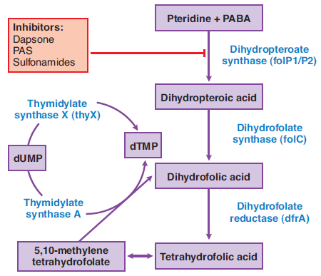
DAPSONE – MECHANISM OF ACTION

Slide 3
DAPSONE - PHARMACOKINETICS
t ½ - 20-30 h
N-Acetylation by NAT2
Excreted in urine.

Slide 4
DAPSONE
ADVERSE EFFECTS:
Hemolysis (200-300mg/day)
Methemoglobinemia
Reversible peripheral neuropathy
CONTRAINDICATION:
G6PD deficiency

Slide 5
CLOFAZIMINE – MECHANISM OF ACTION
Membrane disruption
Inhibition of microbial K+ transport
Generation of hydrogen peroxide
Interference with the bacterial electron transport chain
Efflux pump inhibition

Slide 6
CLOFAZIMINE - PHARMACOKINETICS
Oral bioavailability – 45%-60%
Distributed into tissues – reddish black discoloration
Metabolized in the liver.

Slide 7
CLOFAZIMINE – ADVERSE REACTIONS
GI problems
Crystalline deposition
Body secretion/eye/skin discoloration

Slide 8
WHO – LEPROSY REGIMEN
Paucibacillary therapy:
Rifampin – 600mg once a month – 6 months
Dapsone – 100mg Daily – 6 months
Multibacillary therapy:
Rifampin – 600mg once a month
Dapsone – 100mg Daily
Clofazimine – 300mg once a month, 50 mg daily
For 12 months

